Slide 1
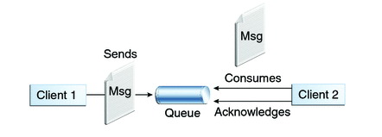

Spring Boot JMS ActiveMQ Example
Queues [point-to-point]: Queue’s are based on point-to-point messaging model where messages are sent to a queue. Each message has exactly one sender and one receiver. Message is guaranteed to be delivered to only one receiver.
MessageProducerApplication.java
MessageReceiver.java

Slide 2
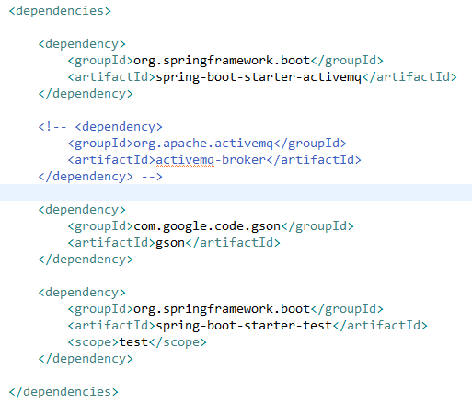
Spring Boot JMS ActiveMQ Example
spring-boot-starter-activemq: It provides all the required dependencies to integrate JMS and activemq with spring boot.
activemq-broker: This provides embedded activemq in spring boot application. But since, we will be configuring our activemq outside the application we have commented it for time being.
spring-boot-maven-plugin: It will collect all the jar files present in the classpath and create a single executable jar.

Slide 3

Spring Boot JMS ActiveMQ Example
Following is the application.properties which has configurations for activemq. Here we are configuring the tcp broker url along with the username and password required to make activemq connection

Slide 4
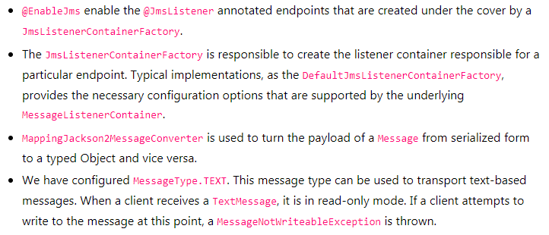
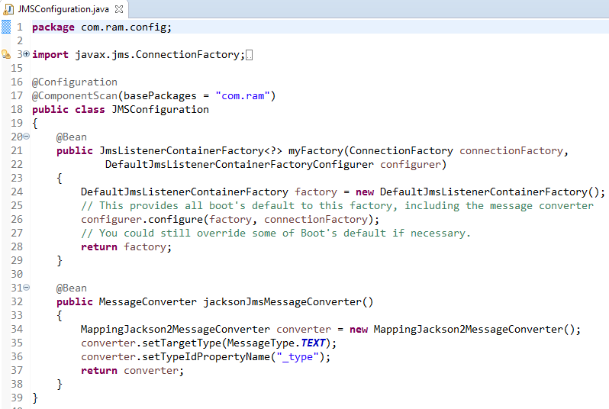
Spring Boot JMS ActiveMQ Example

Slide 5
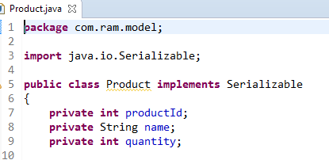
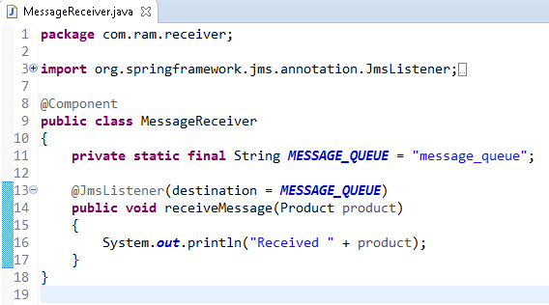
Spring Boot JMS ActiveMQ Example
Message receiver class is pretty much simple class with single method with annotation @JmsListener. @JmsListener allows you to expose a method of a managed bean as a JMS listener endpoint.
So whenever any message is available on configured queue (in this example queue name is “message_queue”), annotated method (i.e. receiveMessage) will be invoked.

Slide 6

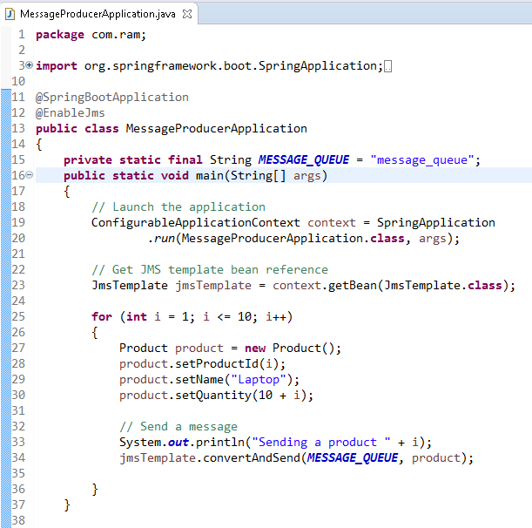

Slide 7
